Slide 2
What is a Memorandum?
Generally speaking, the memorandum is a kind of formal communication which usually operates within an organization.
A memorandum can also be said to be a correspondence between employees of a place of work.
The memorandum differs from the formal letter basically in its formal features, its range of circulation, and in its range of formality.

Slide 3
Memorandum Versus Formal Letter
Formal letters are basically formal because they exhibit a remarkable degree of distance between people in communication.
On the other hand, memorandum exhibits a wide range of formality which can be classified into the formal, informal and semi-formal. It suffices to say that such clear distinctions and ranges are not easily associated with the formal letter.
Memorandums in themselves are considered less formal than formal letters which bridge the distance between communicators who believe that they have been brought much closer together by the common organization they serve.

Slide 4
Cont.
At the workplace, therefore, matters which tend to emphasize an individual’s goals, or those which tend to pitch the organization against and individual are communicated through the formal letter, instead of the memorandum.
It is in the sense of this social framework that appointment, promotion, leave, query, resignation and dismissal correspondence are communicated as formal letters and not as memorandum.

Slide 5
Types
The memorandum can be classified into the informal, the semi-formal and the formal.
The Informal Memoranda
These are hand-written, conversational messages of simple requests, directives or information between employees of an organization. They are usually made up of between one and six lines.
An informal memorandum usually operates between equals or between officers and their subordinates. These memoranda do not usually follow the three-part structure (introduction, body, conclusion).

Slide 6
Cont.
Officers do not usually keep record of these memoranda because they are considered as one of the many short messages which people give us in our daily lives. The language of the informal memorandum is basically colloquial.
The use of contracted forms, abbreviations, and elliptical constructions are a mark of this colloquial language. Below is an example of an informal memorandum culled from Sekyi-Baidoo (2003).

Slide 7

PRINCE DORMENYO 4 POSSA PREZ ‘22

Slide 8
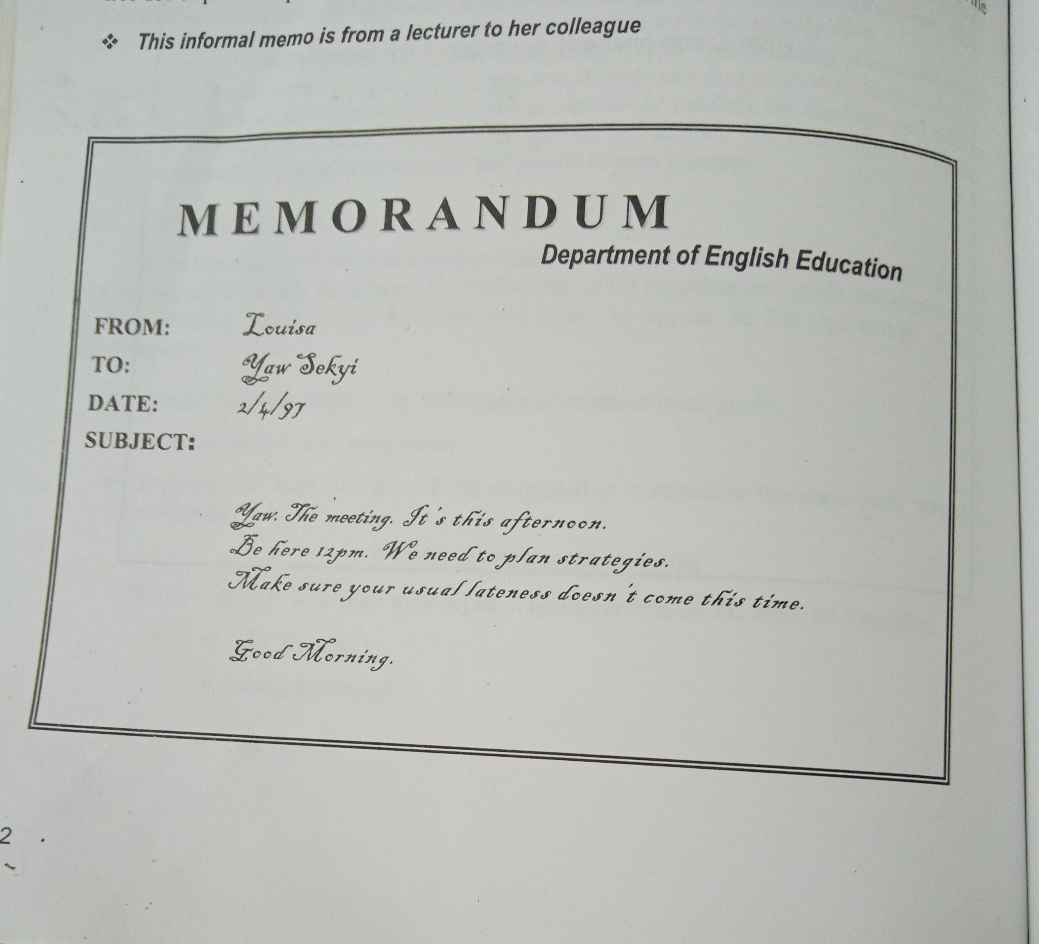

Slide 9
The Semi-formal Memorandum The semi-formal memorandum is a communication between equals, between an administrator and his subordinate or between a subordinate and an immediate boss between whom there is not much difference in status or rank. The semi-formal memorandum, like the informal one, is also concerned with day-to-day activities of the organization. It contains a well discussed or fully presented subject. It does not contain snippets of directives or information. Unlike the informal ones, the semi-formal ones are filed. These memoranda usually follow the three-part structure (introduction, body, conclusion). The language of this form of memorandum is simple, everyday vocabulary construction except in instances when the nature of the subject demands specialized vocabulary. Even when this happens, it is believed that the workers understand it. Below is an example of a semi-formal memorandum culled from Sekyi-Baidoo (2003).

Slide 10
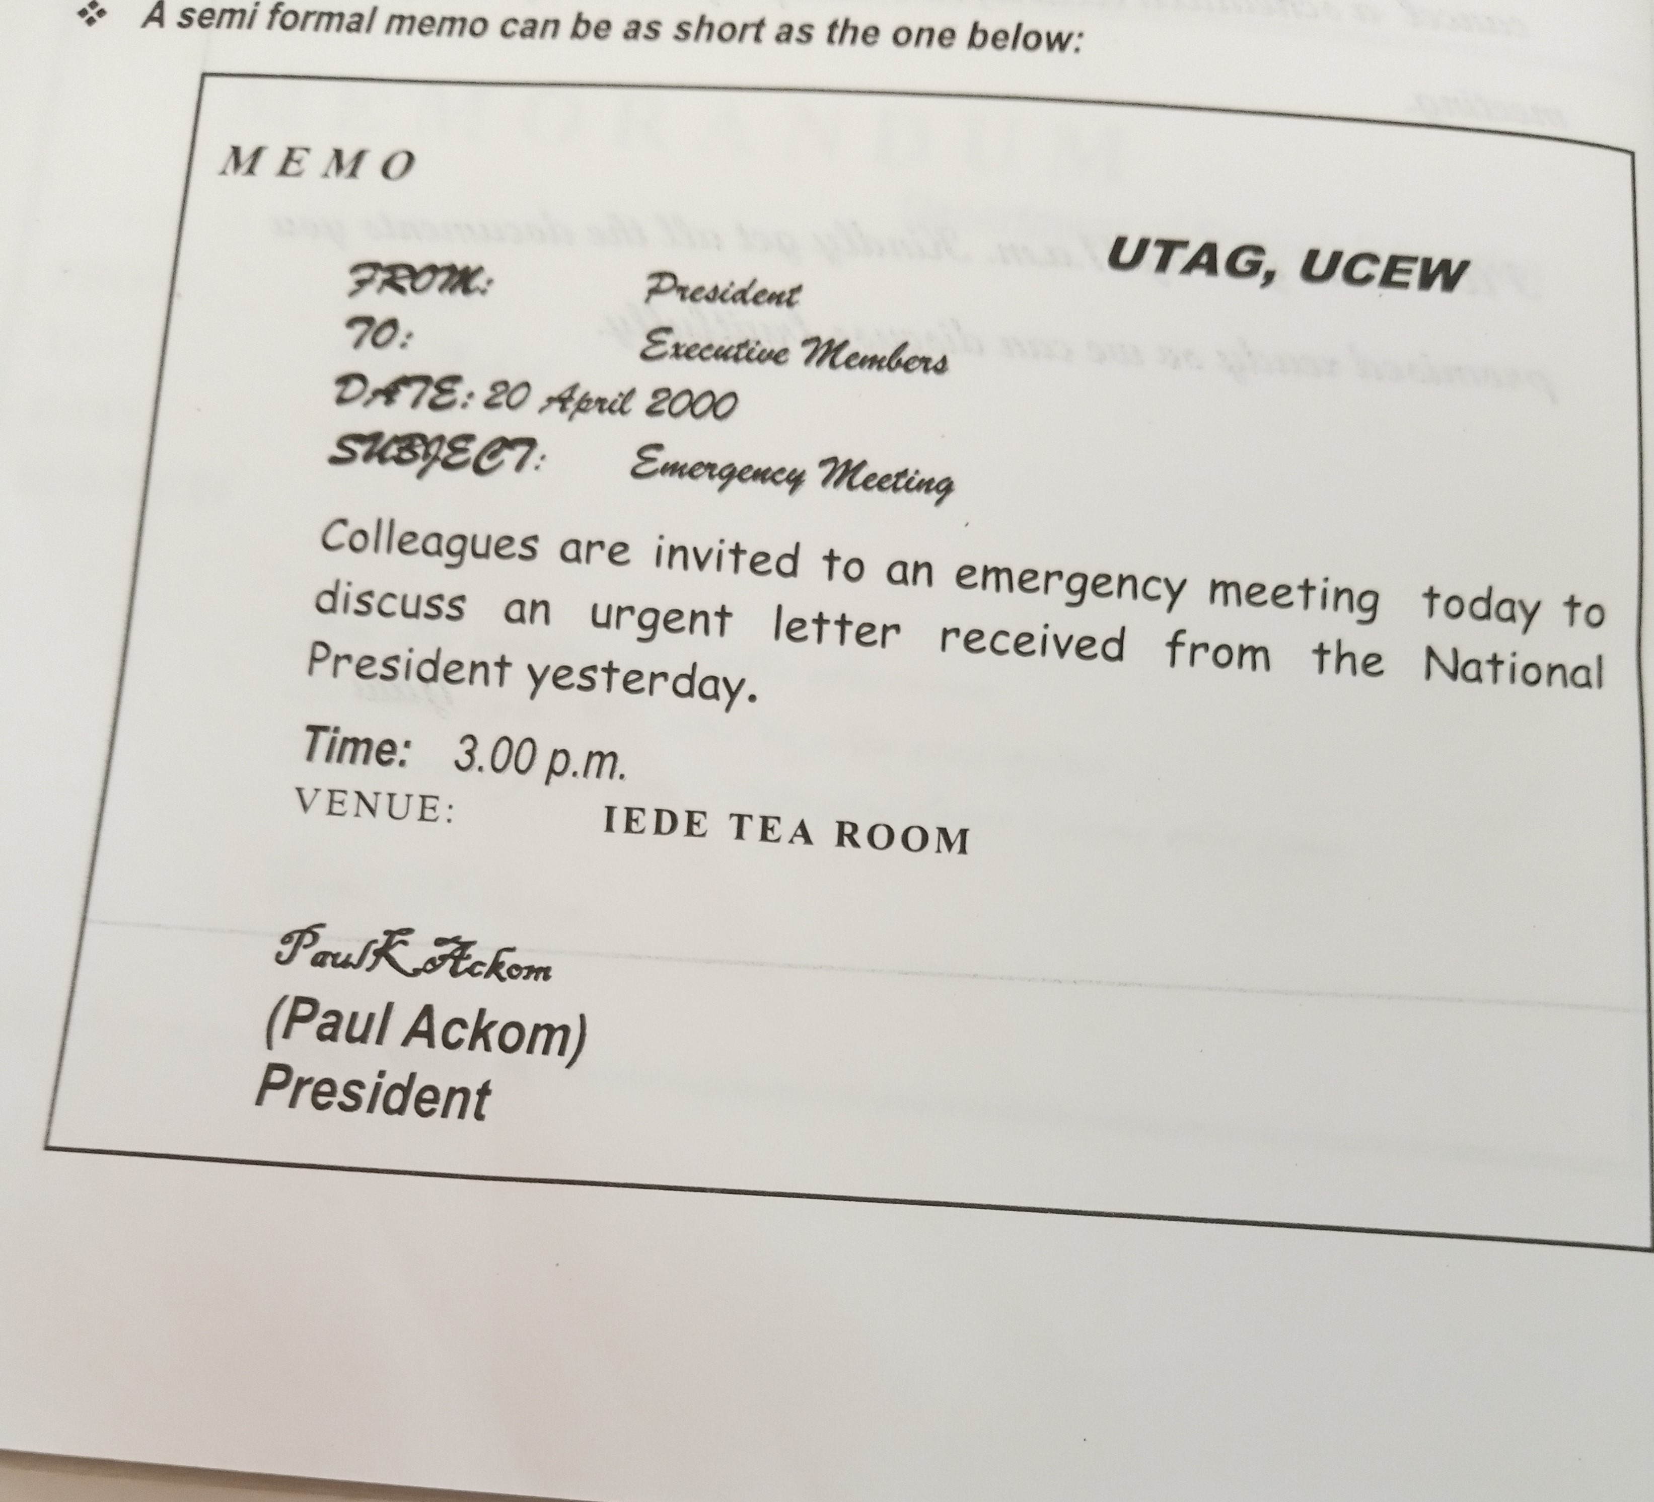

Slide 11
The Formal or Policy Memorandum
The formal or policy memorandum can be likened to the formal letter in the distance that exists between the employees in communication. It is concerned not with day-to-day information and activities but with general policies and directives. It is usually an announcement, explanation, suggestion, or reaction based on the principles and practices on which the organization operates. It is as a result of its preoccupation with organizational principles and practices that it is called policy memorandum.
Policy memorandums are usually addressed to communal recipients such as All Employees, All Managers, All Heads of Departments or individuals with official designation such as The Head, The Secretary, The Minister etc.

Slide 12
Cont.
These memorandums follow the three-part structure (introduction, body, conclusion).
The language of formal memorandum is formal and therefore uses the impersonal method generally. The use of passives and genitives(instead of specific names) reflect its impersonal nature. It is important to avoid the use of colloquial language in formal memos. The use of contracted forms, abbreviations, and elliptical constructions are a mark of this colloquial language. Below is an example of a formal memorandum culled from Sekyi-Baidoo (2003).

Slide 13
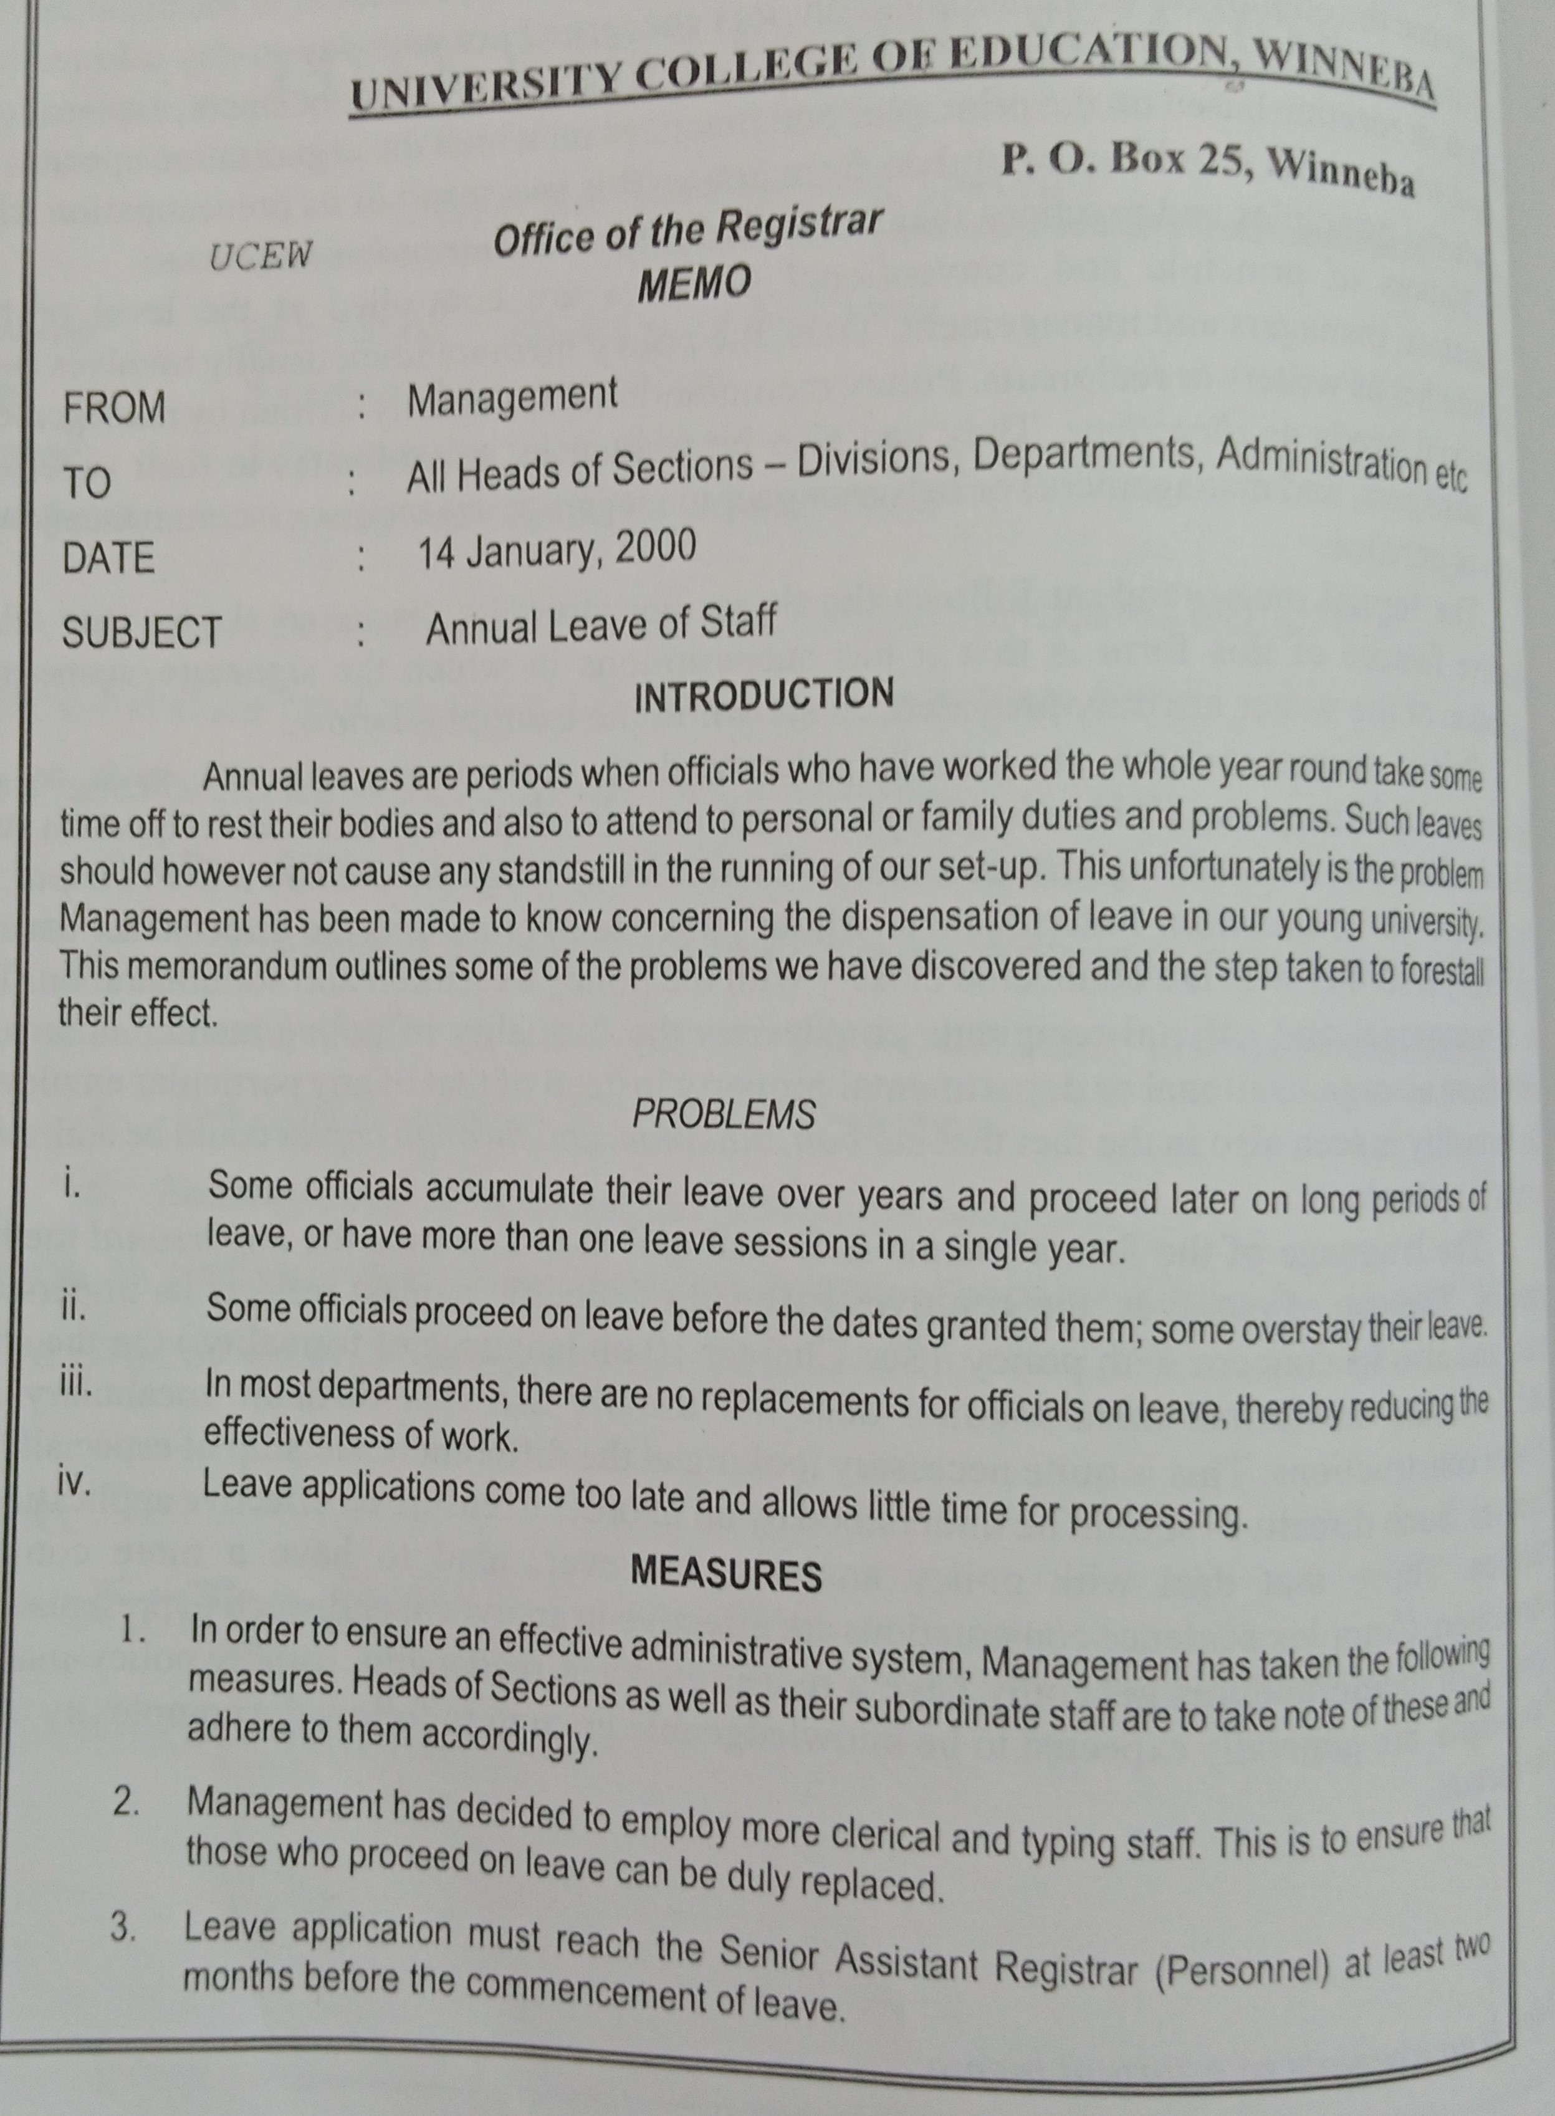

Slide 14
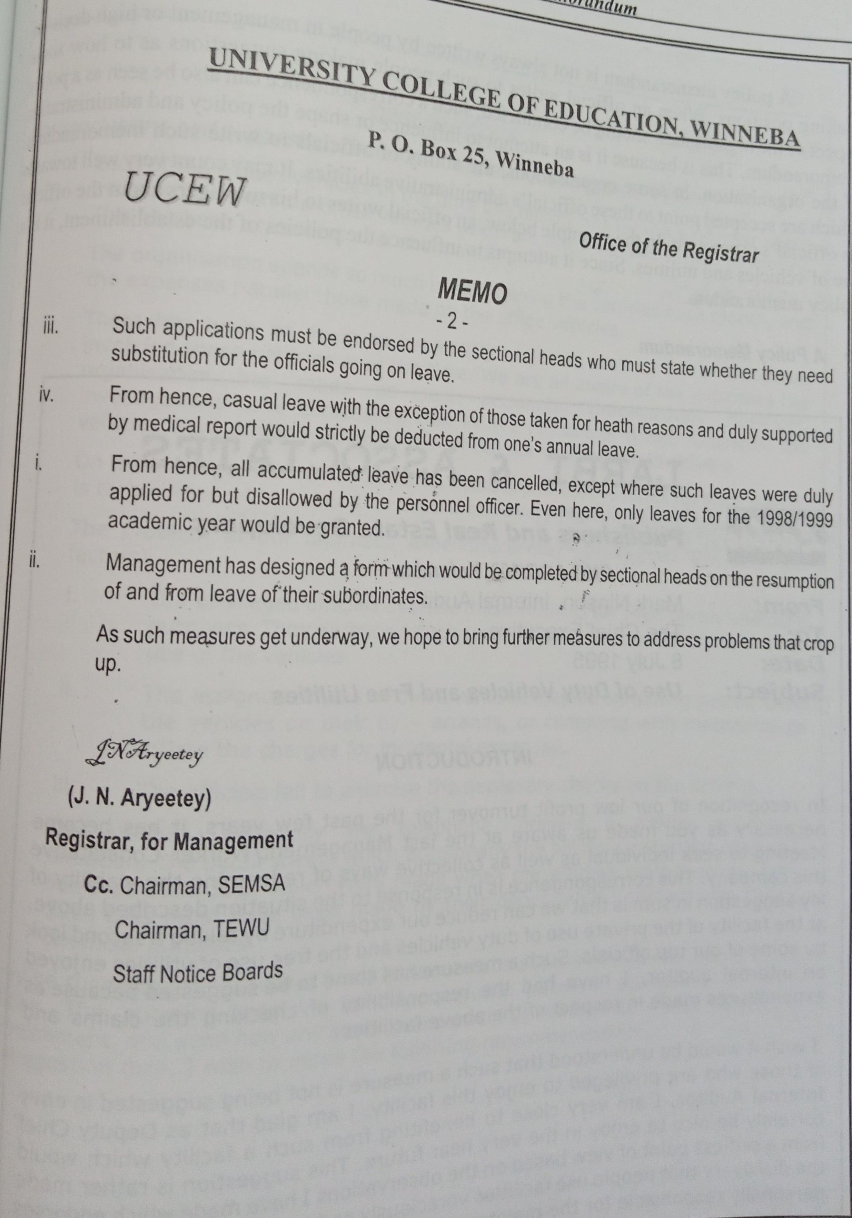

Slide 15
Structure of a Memorandum
Departments often design their “memo pads” with the following features:
1. Corresponding heading: This is the heading which appears at the top usually in bold print and seeks to identify the nature of the correspondence.
For most organizations this heading, comprises the word Memorandum or Memo.
Others such as Office Memo, Interoffice Correspondence and Interoffice Communication are sometimes used in place of memorandum.
Some organizations do not even have this correspondence heading on their memo pads.

Slide 16
Cont.
2. Specific headings: These headings come below the correspondence heading.
They serve to identify the people and the subject or focus of the communication.
It is important in every communication that the people in the communication event are all identified.
In the formal letter, these people are identified in the recipient’s address and salutation on one hand, and the writers address and the subscription on the other.

Slide 17
Cont.
The specific headings comprise the following elements which can be arranged not necessarily in the order below:
From:
To:
Date:
Subject:
Informal and sometimes semi-formal memorandums generally have no subscription. The writer may only write a ‘Thank you’ or initial his/her name at the end of the correspondence. It is now however customary for formal and some semi-formal memorandums to display the signature, the name and the designation of the writer.

Slide 18
Uses of a Memorandum
Memorandums are used within an organization to:
Report information
Make requests
Recommend an action
Communicate issues of immediate importance
Organization can also send memos to people or firms that have close or long-standing relationships with them.

Slide 19
Types of Modern Communication
Other types of modern communication have been around since the early days of phone and internet. Some of these include:
Voice Calling
SMS Text Messaging
Email
Social Media

Slide 20
Assignment
Explore other types of modern communication used in organizations.

Slide 21
PRINCE DORMENYO 4 POSSA PREZ ‘22

